Slide 1



“Predicting the Effects of Renewable Energy Production on the GDP”
Course Name: MBAI 5100: Business Analytics Date of Presentation: 25th November, 2024
Team Members (in order of speakers)
1. Manas Varma (100975097) 2. Youssef Soliman(100994984)
3. Neel Patel (100985884)
Notes:
Good evening, everyone. Thank you for being here.
My name is Manas Varma, and along with my team members Youssef Soliman, and Neel Ashwin Patel, we are presenting our project: Predicting the Effects of Renewable Energy Production on GDP.
Today, we will dive into how renewable energy impacts economic growth and the models we used to explore these relationships.

Slide 2

Introduction
Renewable energy is essential for reducing global carbon footprints.
“Predicting the economic impact of renewable energy is critical for guiding investment and policy.”
Objective: To build predictive models for GDP using renewable energy data spanning several years and countries.
Relevance: Policymakers can use this to design effective carbon tax and renewable energy incentives.
Notes:
We all know renewable energy is highly essential for reducing carbon footprints — it has profound economic implications as well.
Our objective is to build predictive models for GDP based on renewable energy data, enabling policymakers to design effective carbon taxes and incentives.
This work ties directly to the United Nations’ Sustainable Development Goals, which I will speak for in the upcoming slide.
By analyzing how clean energy transitions influence GDP, our project aims to provide actionable insights for governments and businesses.

Slide 3


United Nations Sustainable Development Goals 7
Our project explores the economic impacts of renewable energy production, emphasizing how transitioning to clean energy sources can drive sustainable economic growth. By analyzing the relationship between renewable energy production and GDP, the project supports SDG 7’s aim to "ensure access to affordable, reliable, sustainable, and modern energy for all."
It aligns with the goal's objectives by:
Highlighting the economic benefits of clean energy transitions.
Encouraging policies and investments in renewable energy to reduce carbon footprints.
Providing insights for governments and businesses to leverage clean energy for economic growth, ensuring sustainability while reducing dependence on fossil fuels.
Notes:
This is something we all had in mind once we thought of our initial project topic and what we are aiming to cover.
As our project examines the economic impacts of renewable energy production, focusing on how clean energy transitions promote sustainable economic growth, it is in connection with the United Nations Sustainable Development Goal 7 aim that is “ensure access to affordable, reliable, sustainable, and modern energy for all."
By analyzing the link between renewable energy and GDP, it supports United Nations Sustainable Development Goal Number 7's goal to ensure access to modern, sustainable energy. The study highlights economic benefits, advocates for policies and investments to reduce carbon footprints, and offers insights for governments and businesses to drive sustainable growth and reduce reliance on fossil fuels.

Slide 4

Prediction Problem Statement
Prediction Problem: How does renewable energy production affect a country’s GDP over time?
Importance: Guides policymaking and investment strategies. Aids businesses in assessing economic risks and opportunities tied to renewable energy.
Challenges: Multicollinearity in data. Variability in GDP trends across countries and regions.
Notes:
The core problem we address is: How does renewable energy production affect a country’s GDP over time?
This question is critical for guiding investments and policymaking. It also aids businesses and industries in accessing economic risks and opportunities.
The question is critical, and with that being said, we also faced challenges such as multicollinearity in data and variability in GDP trends across regions, which required robust techniques to resolve.

Slide 5
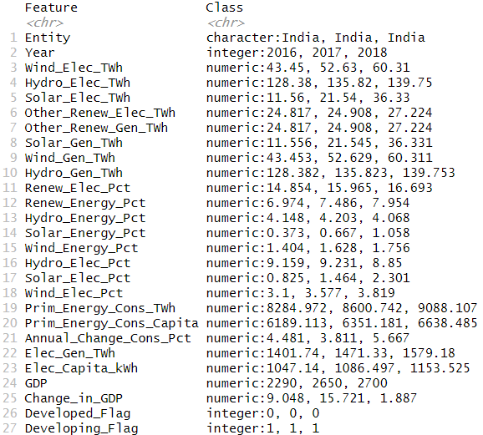
Dataset Details
Sources: Renewable Energy Data: Our World in Data GDP Data: World Bank and OECD
Dataset Characteristics: Total 10+ files (merged into one) 50+ countries Data spans over 30 years (1985–2023)
6,420 rows and 27 columns
Key Variables: Renewable energy production (% of total energy) GDP (current USD)
Unique Contribution: Combines energy and GDP data to address gaps in economic forecasting for renewable energy impacts.
Notes:
We sourced renewable energy data from 'Our World in Data' and GDP data from the World Bank and OECD.
The dataset covers over 30 years, from 1985 to 2023, spanning 50+ countries.
It includes 6,420 rows and 27 columns with key variables like renewable energy production as a percentage of total energy and GDP in current USD.
One unique contribution of our dataset is its integration of energy and economic data, bridging gaps in forecasting renewable energy impacts on economies.
Additionally, GDP values were simplified to billion dollars here as in our dataset it was in multiple place values.
Here for our dataset, GDP is not adjusted with Inflation, dollar value changes or other similar factors.

Slide 6
Data Cleaning Process: Ensuring Data Integrity for Analysis
Key Columns:
Entity: Represents regions or countries.
Year: Time series data.
Metrics: Energy consumption, renewable energy percentages, GDP, etc.
Handling Missing Data
Identify Columns with Missing Values: The countries we analyzed had a few n/a values which required only visual analysis & corrections. For Eg: 1986 had n/a Renewable Energy TWh & 1987 also had 0.
Strategies:
Impute Missing Values: Use mean/median for numerical data, e.g., Prim_Energy_Cons_TWh. Forward-fill or backward-fill for time-series data.
Feature Engineering
New Columns:
Calculate total renewable energy generation: Total_Renew_Gen = Solar_Gen_TWh + Wind_Gen_TWh + Hydro_Gen_TWh.
Categorize countries based on IMF Data: Developing & Developed Status
Caculate Change in GDP % value: GDP - lag(GDP)) / lag(GDP) * 100
Key Highlights for our Data Cleaning Analysis:
Years were selected only for the period of 1985-2023 as it overlapped the most across countries.
We checked for Outliers, but no outlier handling was required.
Notes:
Let’s discuss the steps we took to clean and prepare the data.
Key columns included 'Entity' for countries, 'Year,' and metrics like energy consumption and GDP.
For missing data, we employed imputation strategies like mean and median replacement for numerical fields and forward/backward filling for time-series data.
We also engineered new features, such as total renewable energy generation and GDP percentage changes, to enrich our analysis.
Outliers were analyzed but didn’t require significant adjustments as trends remained consistent across regions."

Slide 7
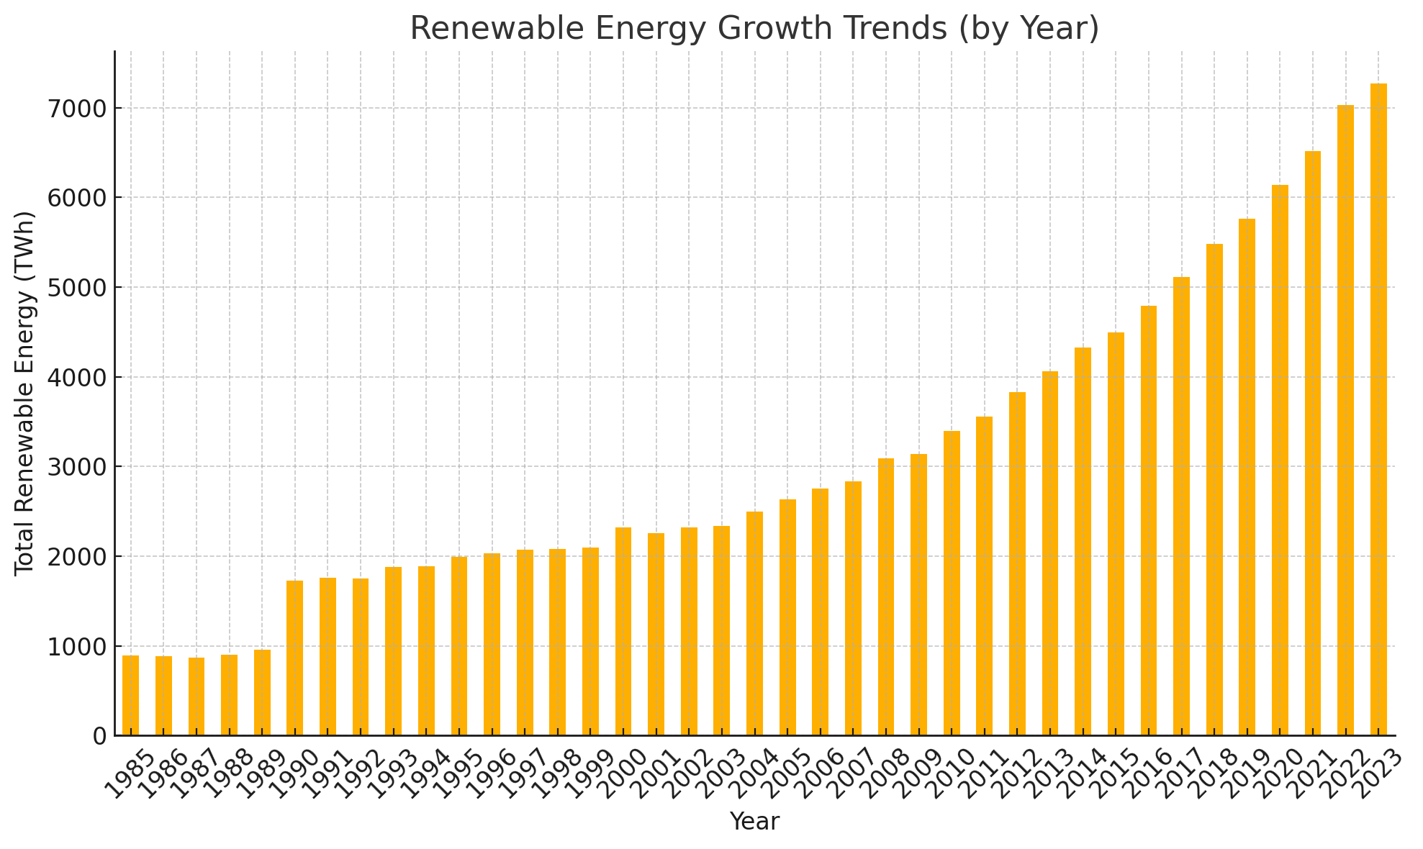
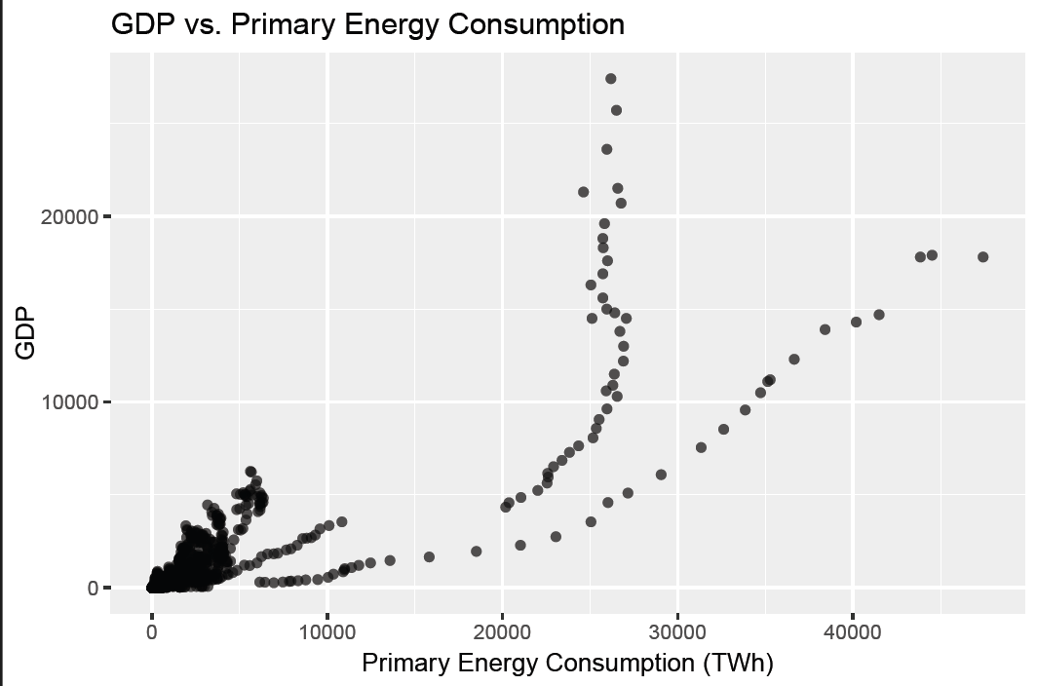
Summary Statistics & Visualizations
Visualizations:
Bar Chart: Renewable energy growth trends (by country and year)
Scatter Plot: Initial correlations between renewable energy share and GDP.
Key Insights:
Countries with higher renewable energy usage show varying GDP trends.
Some outliers, such as oil-dependent economies, complicate correlations.
Notes:
For show & understand our Data Statistics, we used visualizations like bar charts to illustrate renewable energy growth trends and scatter plots to explore correlations with GDP.
We saw that the Total Renewable Energy (all over the world) had increased significantly over the years - proving good for the goal we are aiming for.
One key insight was that countries with higher renewable energy adoption showed varying GDP trends, influenced by factors like oil dependency.
These early findings highlighted the need for more sophisticated modeling to address complexities in the data.

Slide 8


Model Implementations
Linear Regression (📃 linearRegression.R)
Random Forest (📃 randomForest.R)
Results → Linear model was not effective due to multicollinearity issues. Random Forest model yielded good results.
Notes:
-first thoughts was to use linear and random forest as GDP is linear and energy data was also linear as the renewable energy sector is growing
-after test we chose random forest do to data having multicollinearity meaning variable are not independent .

Slide 9
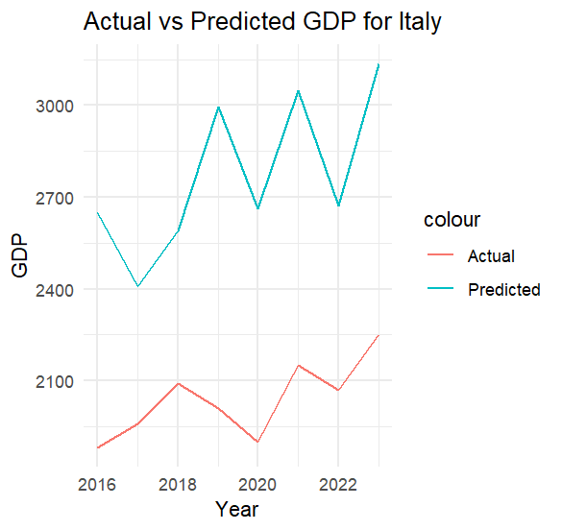
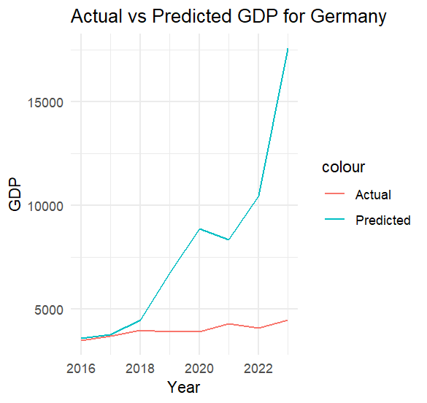
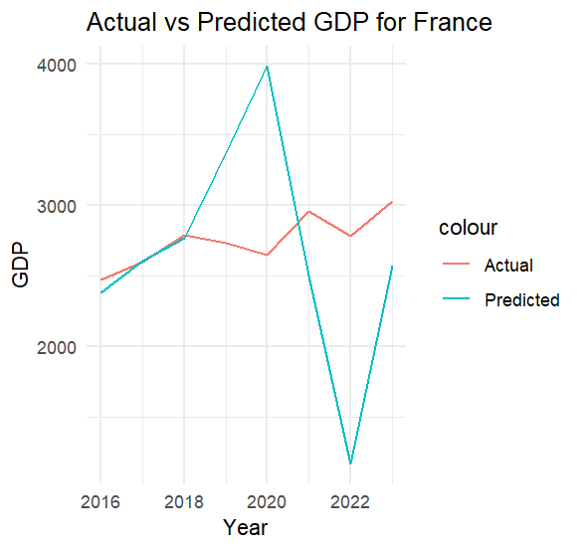
Linear Regression
Outputs
Notes:
-predictions are all over the place and not accurate due to multicollinearity

Slide 10
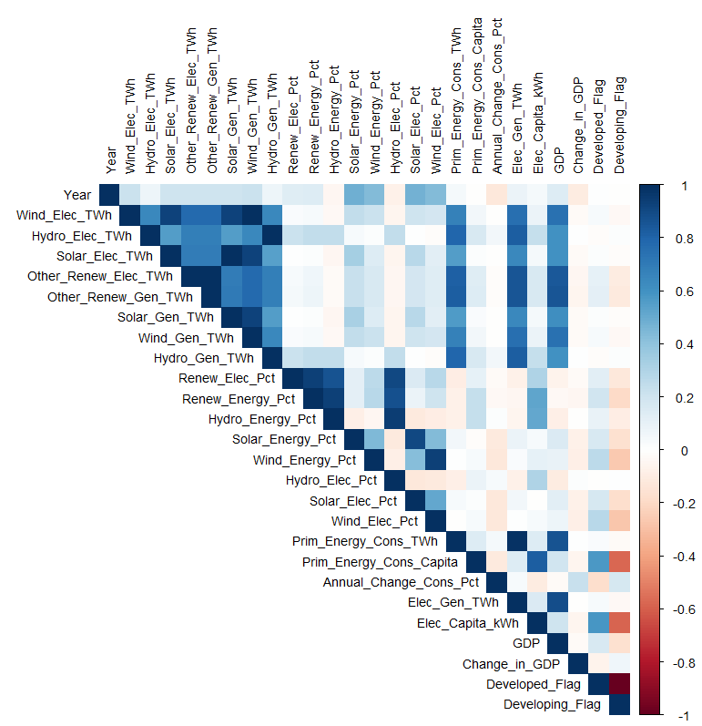
Multicollinearity Analysis
Finding:
Strong correlations among renewable energy features and GDP.
Multi-collinearity matrix shows highly dependent variables.
Implication:
Linear regression is not suitable.
Discovery:
Some renewable energy metrics negatively correlate with GDP growth (e.g., reliance on bioenergy in some regions).

Slide 11
Random Forest Type → Regression

Slide 12
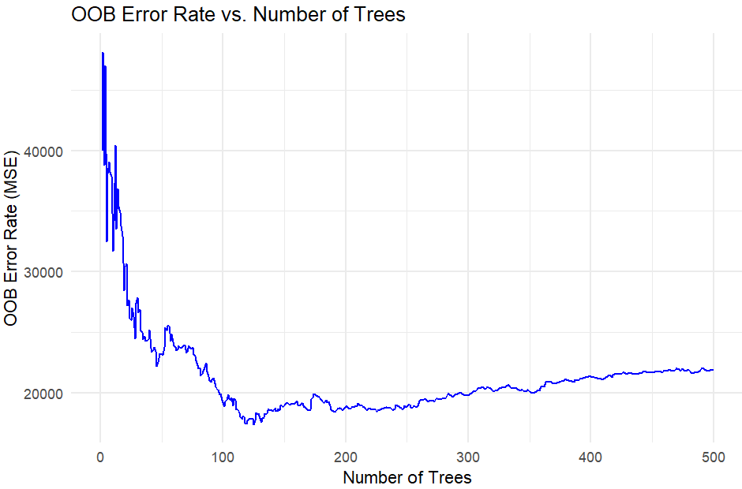
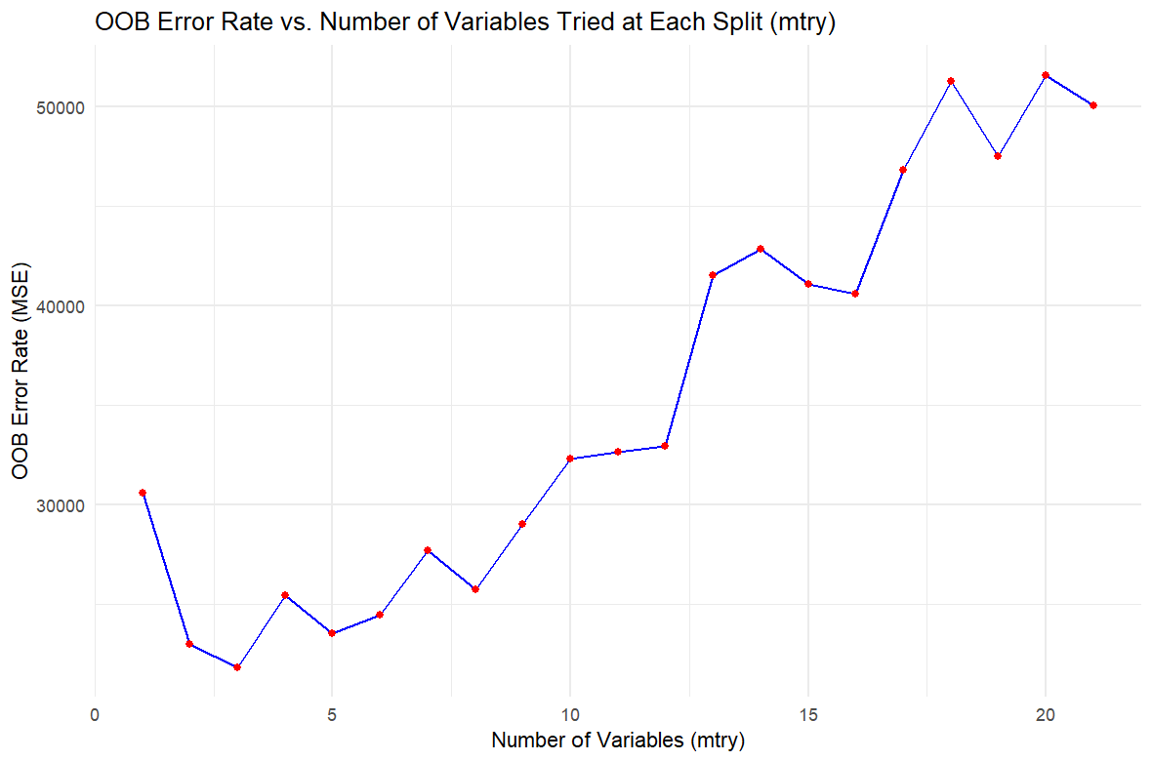
Feature Selection & Hyperparameter Tuning
- We split the data into 80/20 Ratio
-number of trees (OOB error rate graph) and number of features to try combinations (loop - OOB error rate Vs m-try)
Notes:
-Trying to find the optimal number of trees to use
-random forest creates 500 trees, we observer the OOB error rate for each tree
-finding the best number of variables to use after each split -mtry

Slide 13
Linear Regression | Random Forest
NA | Asia | Europe | South America | Middle East | North America
 | India | Germany | Brazil | Saudi Arabia | Canada
 | Type of random forest: regression
 | Number of trees: 500
 | No. of variables tried at each split: 3 | No. of variables tried at each split: 4 | No. of variables tried at each split: 3 | No. of variables tried at each split: 12 | No. of variables tried at each split: 3
 | % Var Explained: 98.13 | % Var Explained: 93.58 | % Var Explained: 89.57 | % Var Explained: 95.31 | % Var Explained: 94.65
Notes:
-number of trees was best for every country at around 500 trees (not india)
-use the OOB error rate Vs m-try to see the best num of variables to see after spilt

Slide 14
Model Outputs & Comparisons

Slide 15
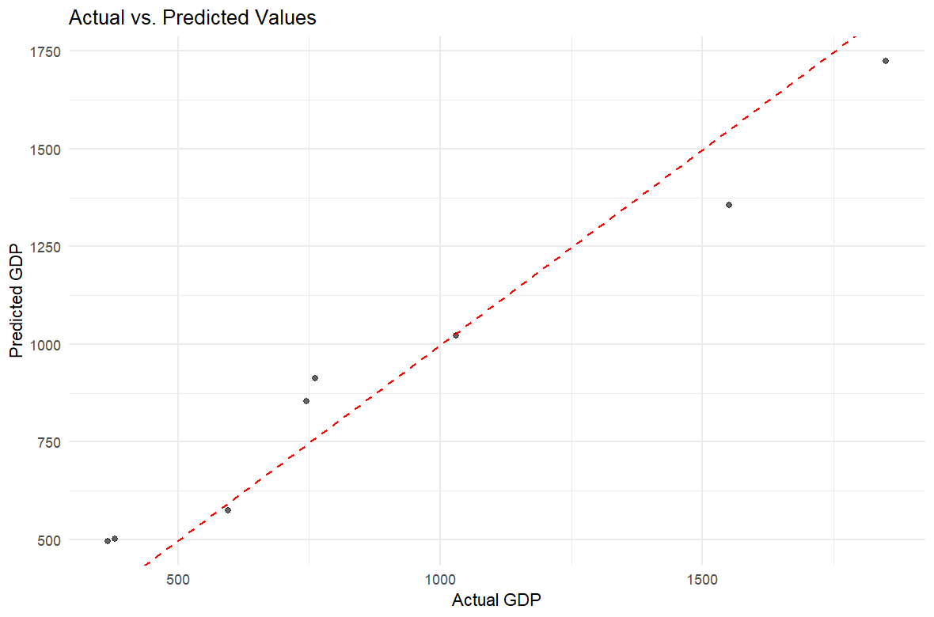
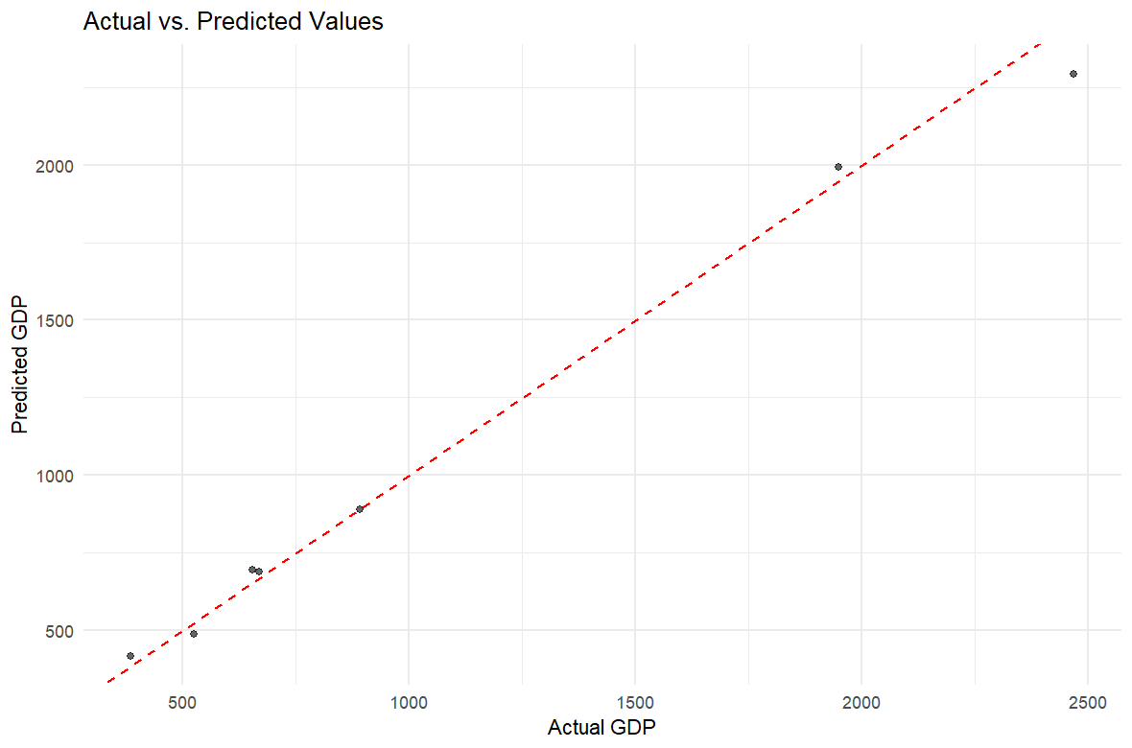


Actuals Vs Predictions (1)

Slide 16
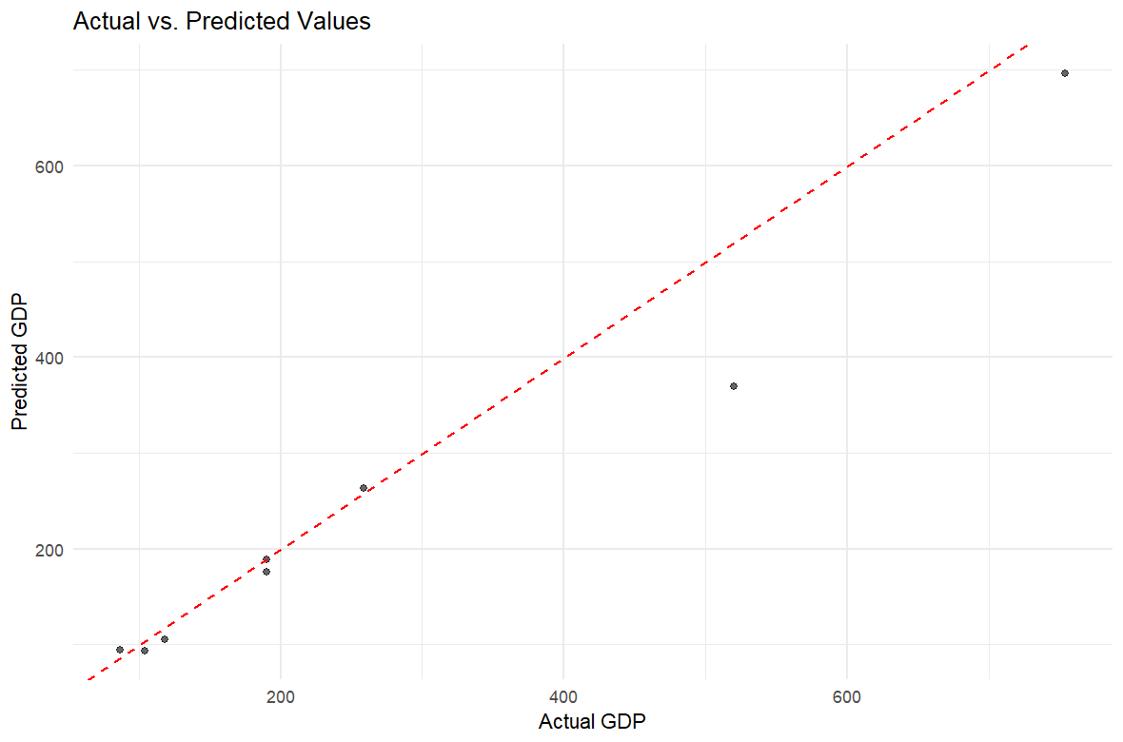
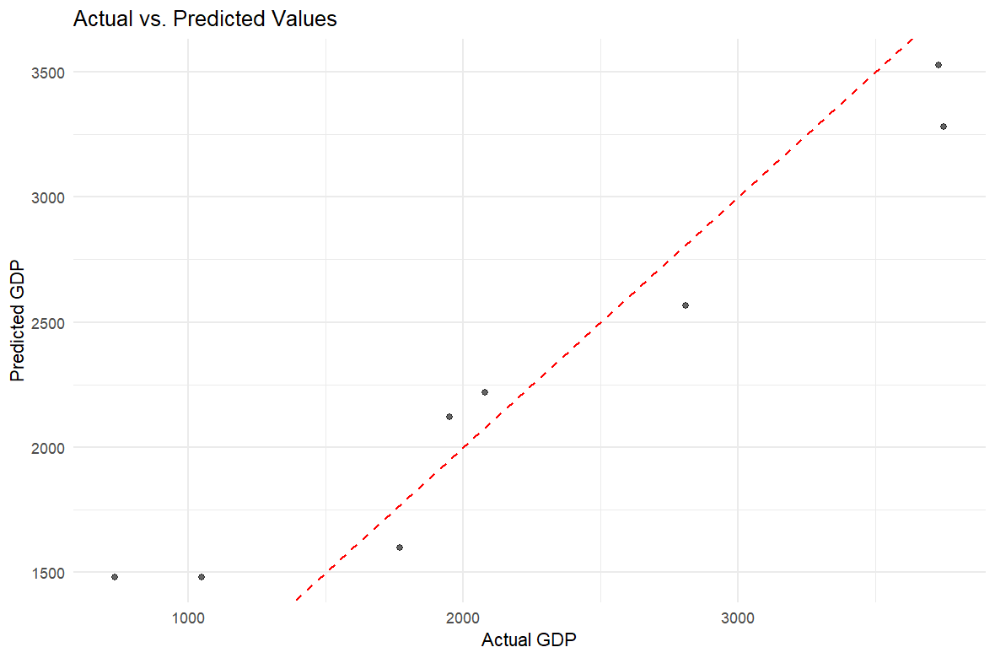


Actuals Vs Predictions (2)

Slide 17
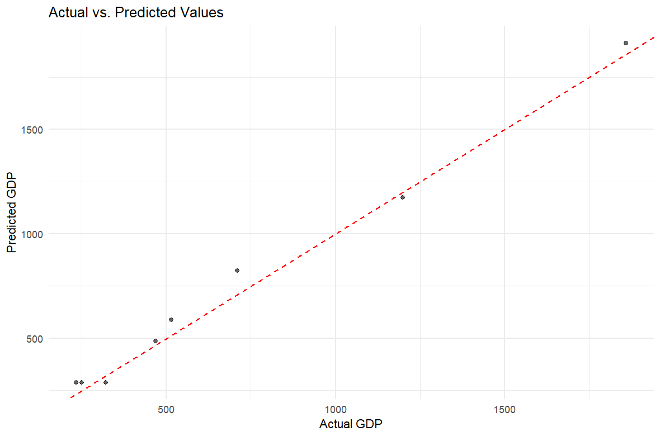

Actuals Vs Predictions (3)

Slide 18
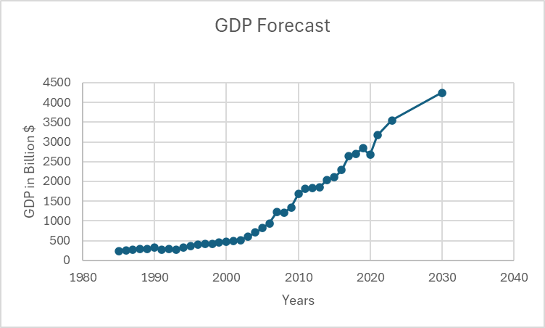
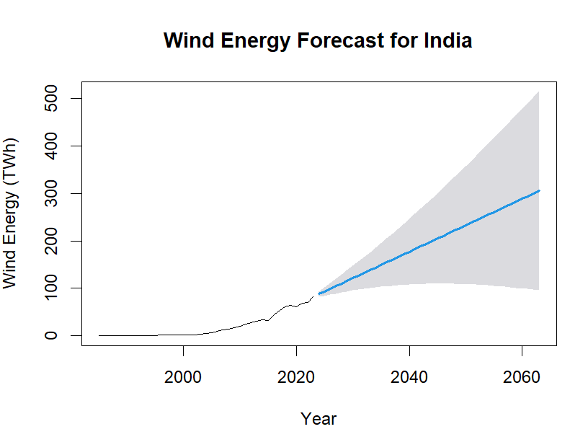
Current Predictions
ARIMA Based Process - Same process can be followed for other 3 countries
However, GDP is not solely dependent on this one feature in real world (we have no accounted for this)
4243.736
121.1778
Notes:
PREDICTING PROCESS
We also went one step ahead and tried predicting the GDP value in 2030 based on it's random forest model. The process we used was, based on the best decision tree produced by random forest we had identified the columns that were being used to make the regression decisions. Then we used ARIMA to forecast the value of those very input variables in the year 2030. We used ARIMA value and the random forest model created to forecast the value.
INDIA 2030
In the interest of time, we could do it for one country of the four where we did find renewable energy showing influence. Here is India's GPD and Amount of Wind Electric Consumed. But, please don't quote us on this in 2030 because GDP is based on huge number of factors apart from energy and electricity. This one is just based on renewable energy. This chart is from excel, because although we produced the forecasted value we are yet to write the code to plot it through R itself. We did forecast inputs for the other countries as well but we are yet to use them in their respective random forest models and plot the forecased value. We are one step away from that.

Slide 19



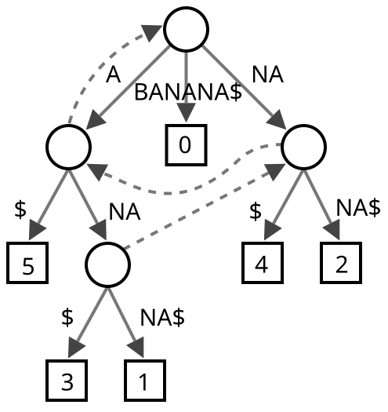
Summary
Energy
Countries
Although it's not the only factor, it does influence GDP.
We have tried our model on highest renewable electricity consuming region’s economies (2022 Report).
Wind Energy
Wind Energy was the most important factor among all renewable ones.
Dataset
We had to understand and wrangle data to make a dataset to use for next steps.
Random Forest
We used this model to train, test and forest GDP.
Notes:
Future Scope:
Code can be extended to create models for other countries as well provided the data does not have NAs or imputing is required
Model can be created for regions, or countries with similar economic nature (e.g. oil based, IT based, developed-developing)
We also have a scope of applying other regression models which work for multicollinear data

Slide 20

Thankyou!

